Slide 1
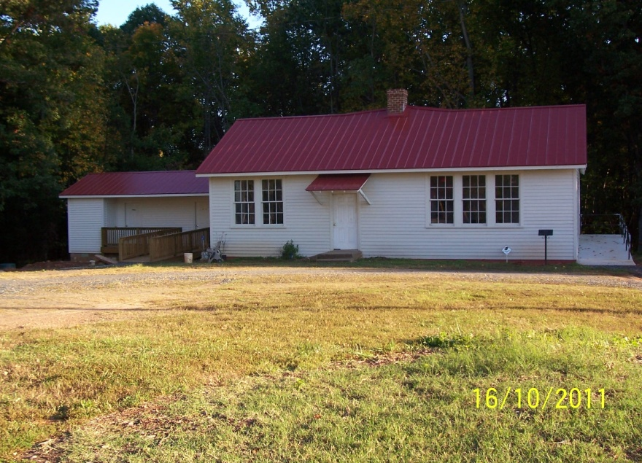
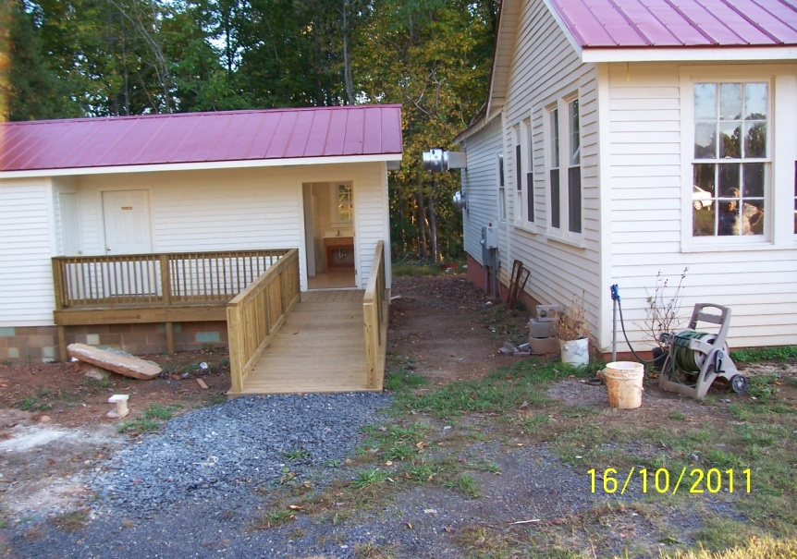
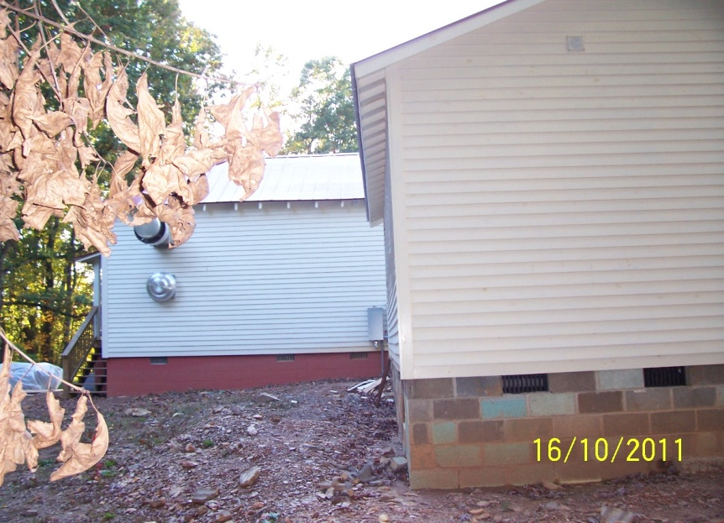
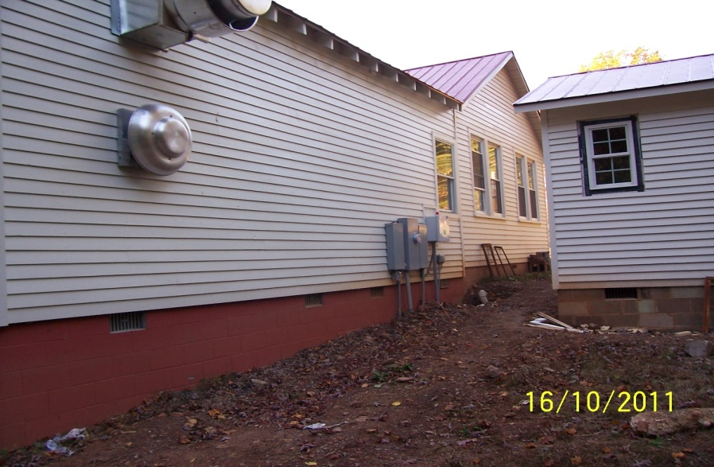
Exterior View
Buckingham Training School Shop Building After Construction
Ellis Acres Park, Inc., 245 Camden Street/ P. O. Box 111, Dillwyn, VA 23936

Slide 2
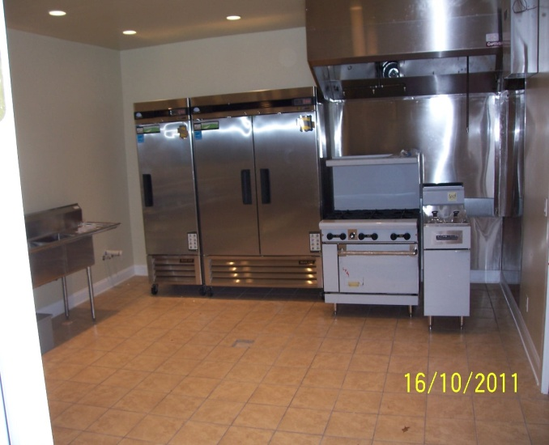
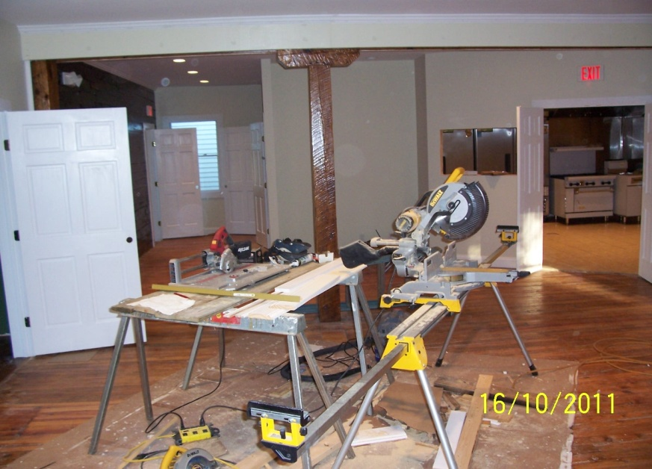
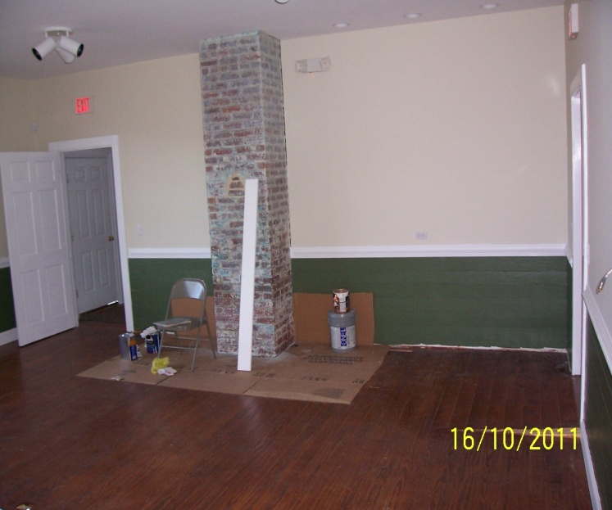
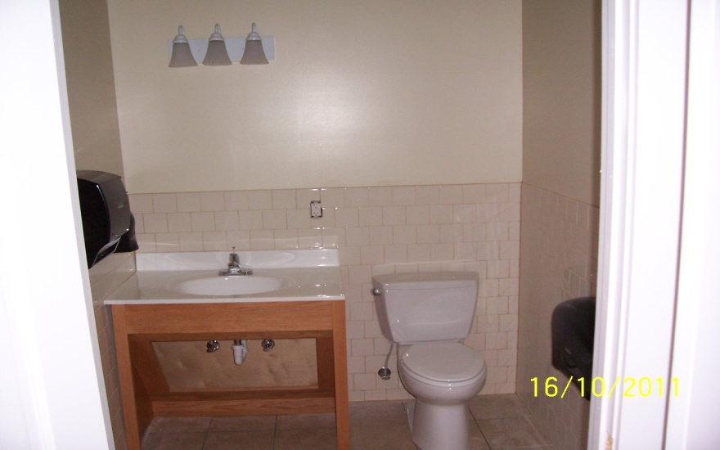
Interior View Buckingham Training School Shop Building In Progress Construction Ellis Acres Park, Inc., 245 Camden Street / P. O. Box 111, Dillwyn, VA 23936

Slide 3
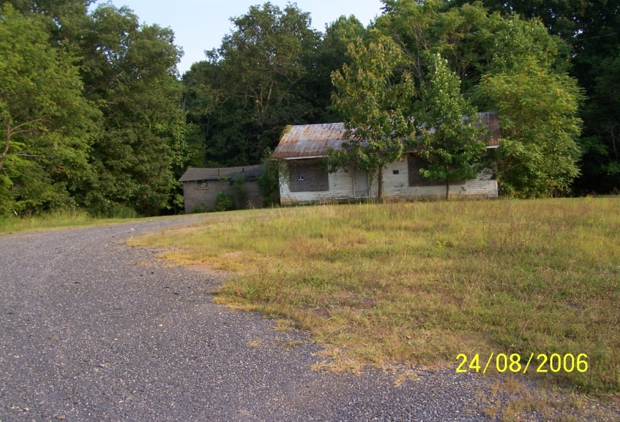
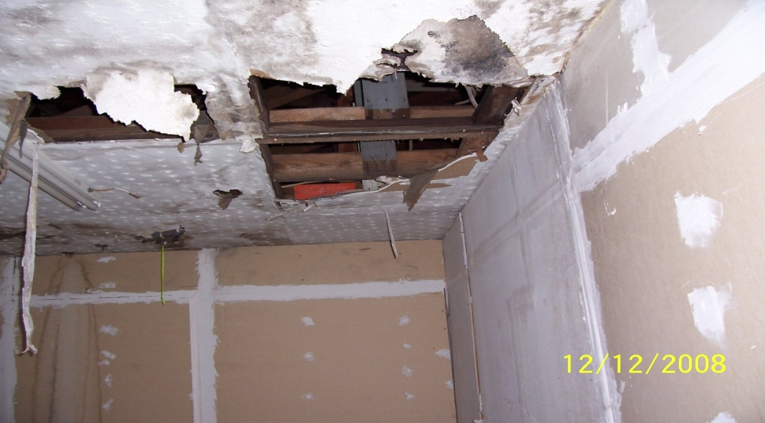
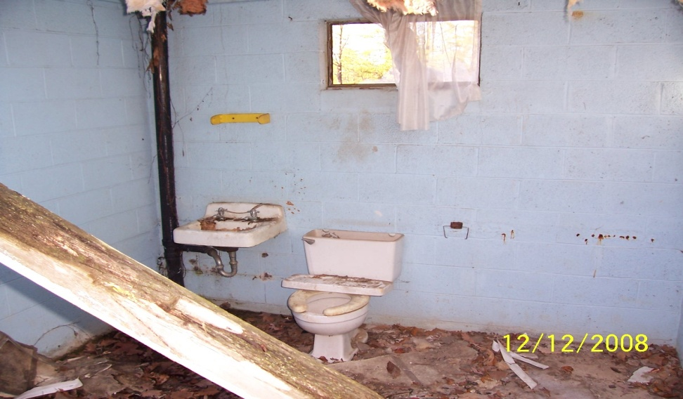
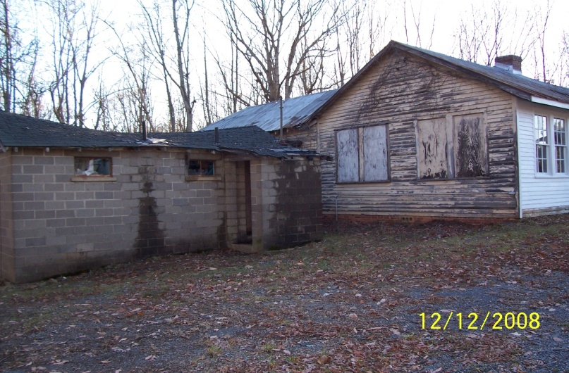
Buckingham Training School Shop Building Preconstruction Ellis Acres Park, Inc. ,245 Camden Street / P. O. Box 111, Dillwyn, VA 23936

